Slide 1
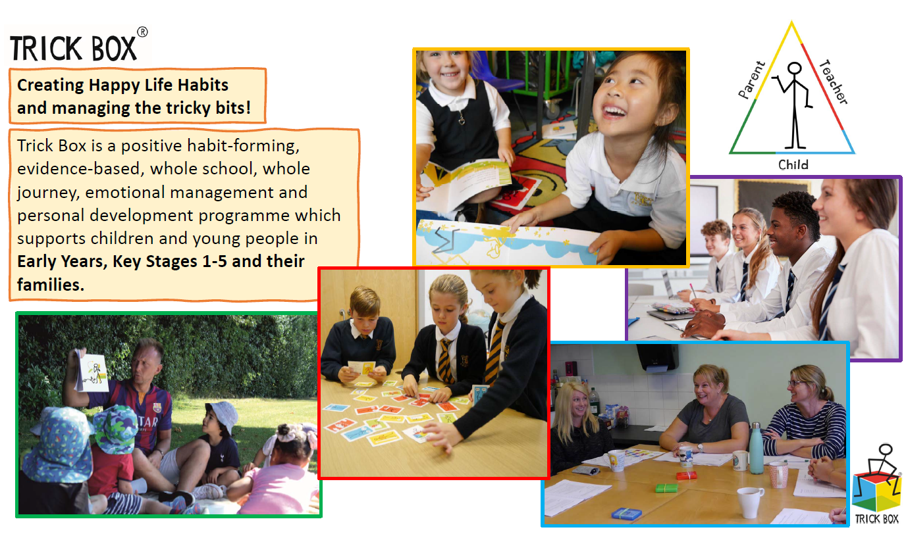

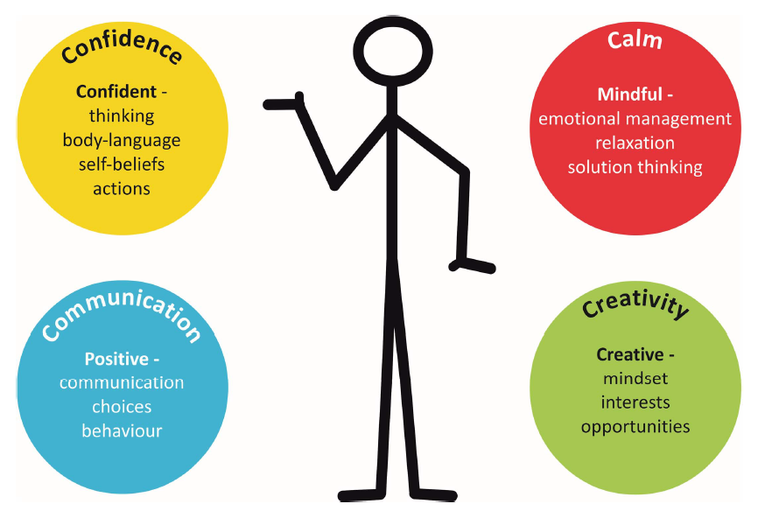




Join us in supporting your child to build their confidence and communication skills, manage emotions and find solutions to challenges.
The Trick Box programme develops personal skills in 4 key areas through positive habit formation. Confidence, calm, communication and creativity.
Together we will practise and model the tricks taught through the PHSE curriculum, encouraging your child to use their new found skills.
The following pages will indicate what tricks are taught each academic year along with the tricks that are continuously practised to ensure embedded learning.

Slide 2






EYFS
Autumn 1
Spring 1
Summer 1
Mirror Mirror
Build a positive self-talk habit.
Breathing Colour
Regulate emotions with controlled breathing.
Win Win
I can be happy and you can be happy.
Demonstrate positive self talk at home. Support your child to give themselves daily positive encouragement.
When I say nice things to myself I feel happy and strong.
Place your hands on your chest and tummy and breathe in slowly – fill your tummy with air. Breathe in through your nose and out through your nose.
I can breath out my angry colour and breathe in my calm colour.
Support your child to be a problem solver - when we want different things can we come up with ideas on how we can both be happy.
We can find a way to both win.
Autumn 2
Spring 2
Summer 2
Floating Cloud
Relax my body to relax my mind.
Free Flow
Be confident to try new things.
Stand Tall
Display confident and strong body language.
Practise squeezing your muscles nice and tight – and then relax – let out a big sigh!
Tense each of your muscles from your feet to your nose!
I can imagine I am floating on a big soft fluffy cloud. I am relaxed from my head to my toes.
Praise your child for trying new things - regardless of their success. Encourage the art of practise and help them to reflect on their own progress.
I can practice the things I am good at and I can also try new things.
Encourage your child to use self-assured and strong body language. Show them how to walk tall, look up and move confidently.
I feel good today, I feel strong inside, I feel confident – I am standing tall.

Slide 3


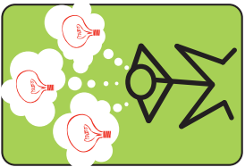
YEAR 1
Autumn
Spring
Summer
Big Voice
I will learn to believe in my self.
Sunny Side
Develop positive thinking patterns.
Light Bulb
Become a problem solver.
Demonstrate self-belief – let them hear you give yourself a pep talk. “I can do it!, I CAN DO IT!”
Encourage your child to use their positive thoughts too.
I believed in myself and never gave up!
Support your child to find the sunny side! It might be raining so we cant go to the park – but that means we can build a den or watch a movie together.
I can choose to think about things in a sunnier way.
Support your child to be a creative thinker – encourage them to ask questions and challenge perceptions. Talk through the possibilities.
“Our usual path to the park is blocked – what could we do?”
I can stop and think and find a solution.
RECAP

Slide 4



YEAR 2
Autumn
Spring
Summer
Magic Circle
Use past experiences to build confidence.
Big No
Set personal boundaries.
Big Yes
Say yes to new experiences.
Boundaries help us feel secure and build our self-esteem. Children must be able to say no when they feel like they are being asked to do something that is unsafe or unkind.
Demonstrate to your child when to say no and show them how to say no with confidence. Use good eye contact and stand tall.
I can say no with confidence.
Support your child to think of a past experience when they have felt good/confident – make a magic circle with your thumb and middle finger – squeeze and think of how good you felt at that time.
When you need a boost of confidence use your magic finger to re-create/build your strong and confident feelings.
I have magic powers – I can boost my confidence!
Saying yes to new things can be fun and exciting but also a little scary. Support your child to listen to their instincts and make their own decisions.
When a new thing is good for us we can use our trick box skills to help build the confidence to say yes.
I can say yes and I can say no!
It is my choice.
RECAP

Slide 5
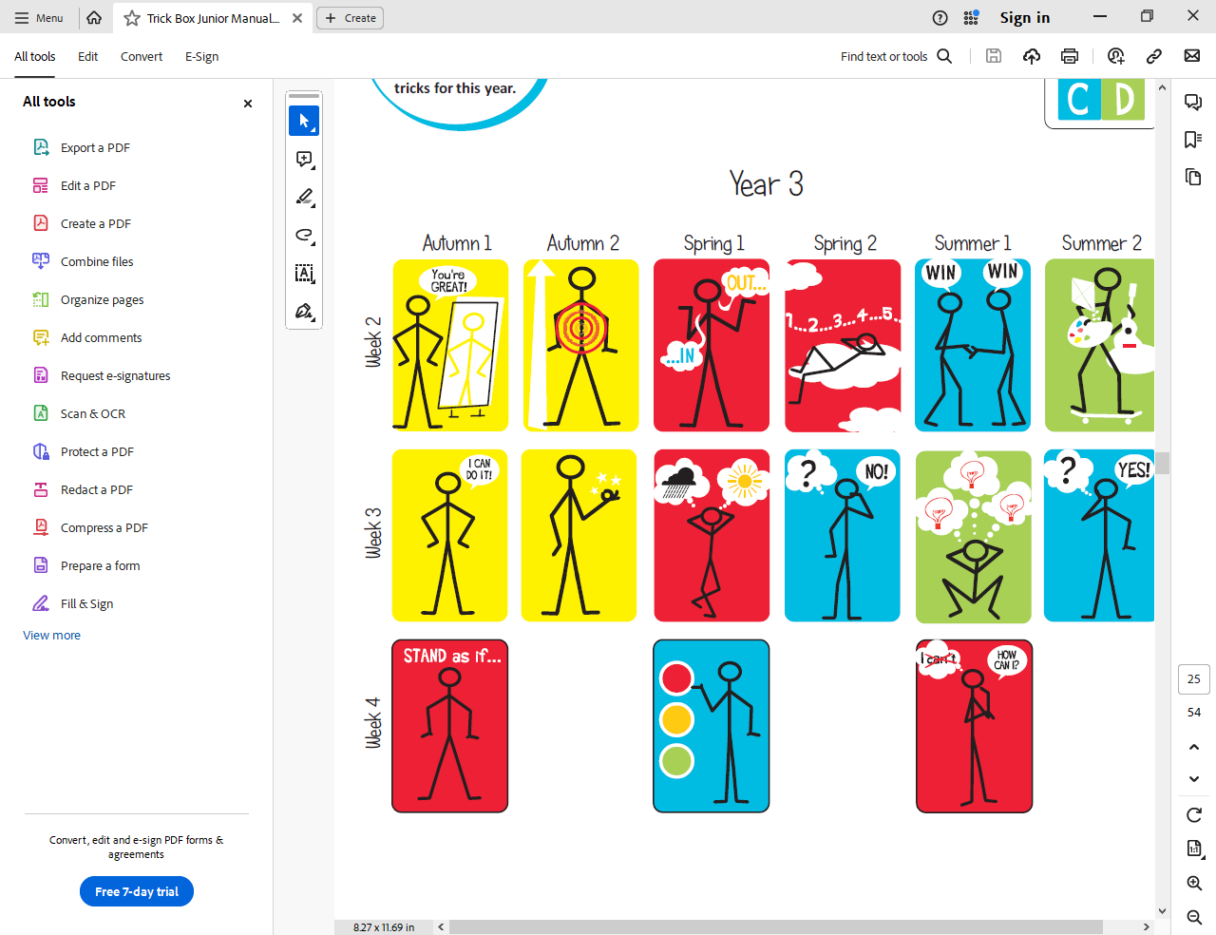
YEAR 3
Autumn
Spring
Summer
Stand as if…
Our mind and bodies work together to help us.
Signal Change
We can choose how we act and behave.
Ask How
Ask ourselves empowering questions
Tell your child about the things they should keep doing – being kind, helping others, sharing.
Refer to the traffic light to signal when your child might need to stop and think about what they are doing. Support them to choose a better option. Make a change!
Stop, think about our choice, make a change.
Discuss with your child how our bodies can sometimes react to our feelings and thoughts. If we are nervous or worried we can sweat, shake or breathe faster.
Encourage your child to Stand Tall, use their Big Voice and Magic Circle to change their body language and build confidence.
I can stand as if I feel strong and brave.
Replace ‘why’ questions with ‘how’ questions…Instead of ‘Why cant I do this?’, or ‘Why did I not achieve the best result?’ Say ‘How can I do this?’ – ‘How can I do better next time?’.
I can use my cleaver brain to think of ideas to get better and feel good.
RECAP

Slide 6
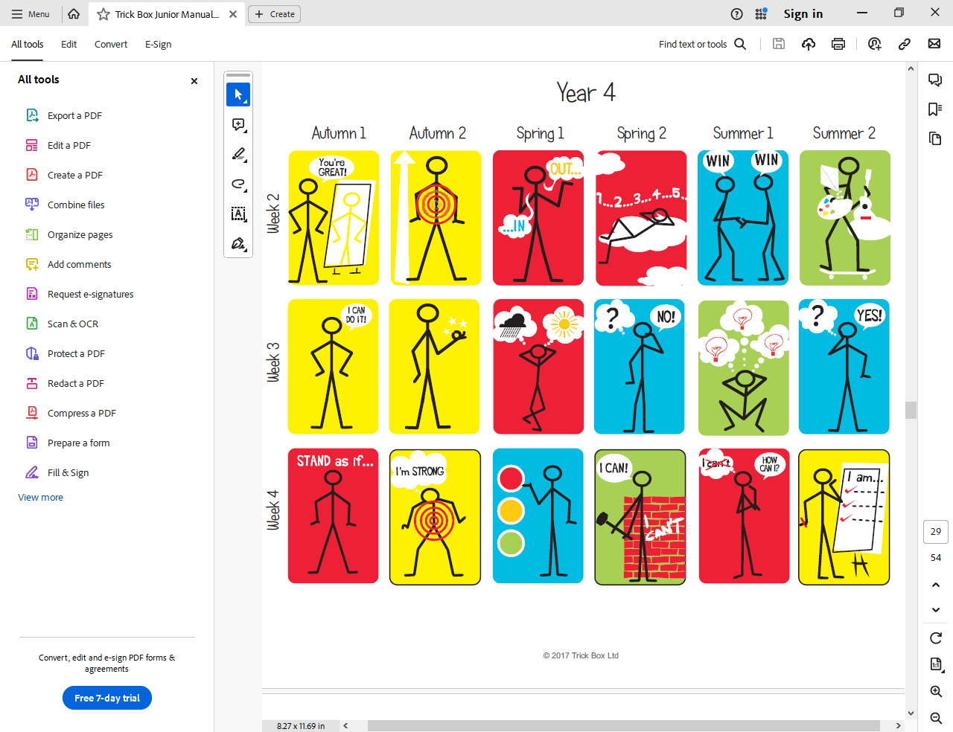
YEAR 4
Autumn
Spring
Summer
Super States
Use positive thoughts to create confidence
Break Through
I can do it!
Brilliant Beliefs
I can be positive about myself and others.
How we are thinking affects how we are feeling and how strong our bodies feel.
Practise with your child to think and feel strong and brave – show them how this makes our bodes look strong and brave too.
If I believe I am strong on the inside, I will look strong on the outside.
Imagine the words ‘I cant do it’ are written on a wall – now imagine breaking through that wall.
Practise this technique with your child and encourage the use of the ‘Big Voice’ trick.
I believe in myself – even when things are hard.
Make a list at home of all the positive qualities you each have – add things to each others list too. Keep them, add to them and use them often as a reminder of your strengths. Get everyone involved!
I will learn more and do more when I feel positive about myself.
RECAP

Slide 7
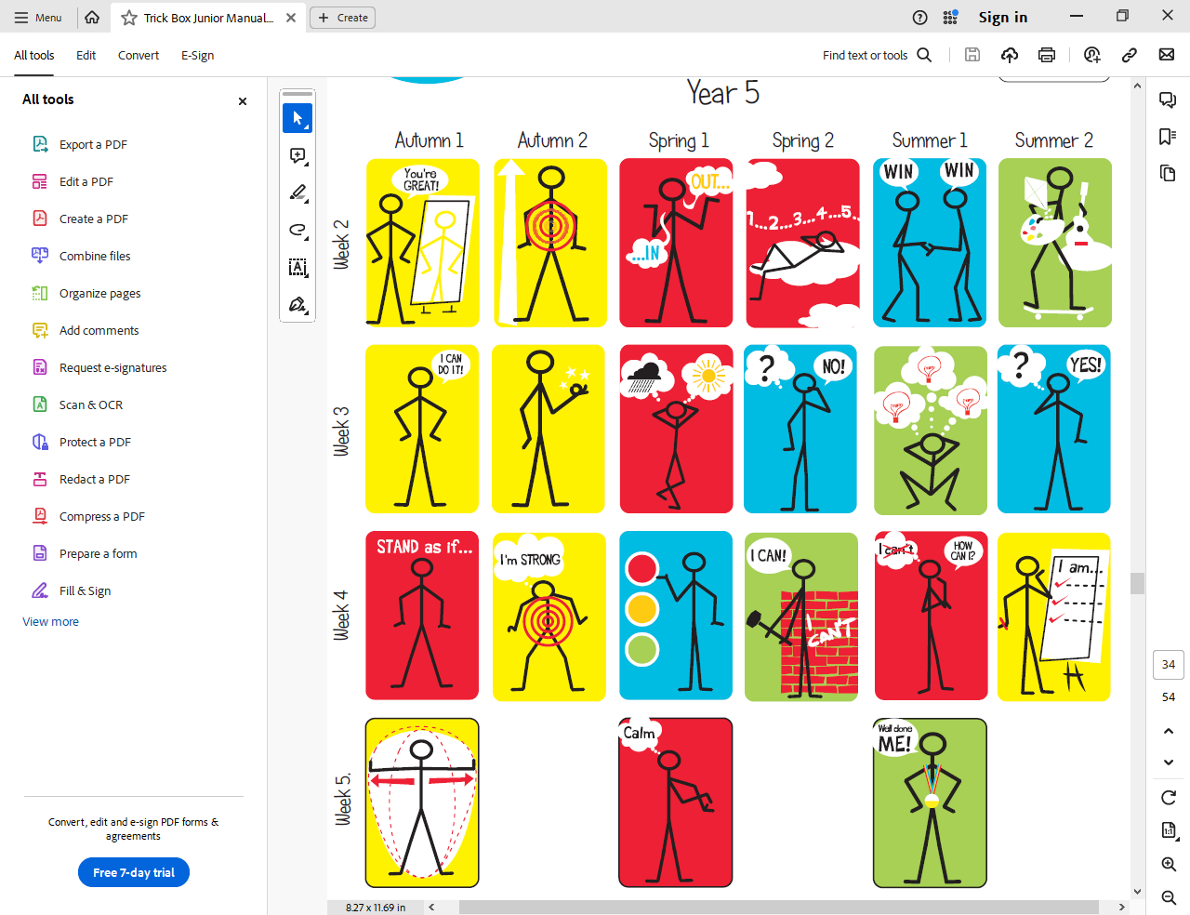
YEAR 5
Autumn
Spring
Summer
Super Stretch
I can widen my comfort zone and experience new things
Calm Thumb
Use an anchor to help find a calmer state
Marvellous Me
Constructive feedback helps me grow
An anchor is an effective way to positively train our body to quickly relax.
Practice together - close your eyes, rub your thumb gently and say the word; “r…e…l….a….x” slowly to yourself. Breathe in and out through your nose, rubbing your thumb all the time.
I can control my physical responses to challenging situations.
It is important to use praise in a balanced and effective way.
When praising your child think how it will motivate or develop them.
Be sure to offer constructive suggestions for improvement alongside your praise.
Learning to accept feedback will increase my confidence and help me develop new skills.
Notice and praise your child when they are stretching their comfort zones – trying new things and taking on new challenges.
(Tricks in recap section will help too)
I can use my confidence building tricks to help expand my experiences.
RECAP

Slide 8
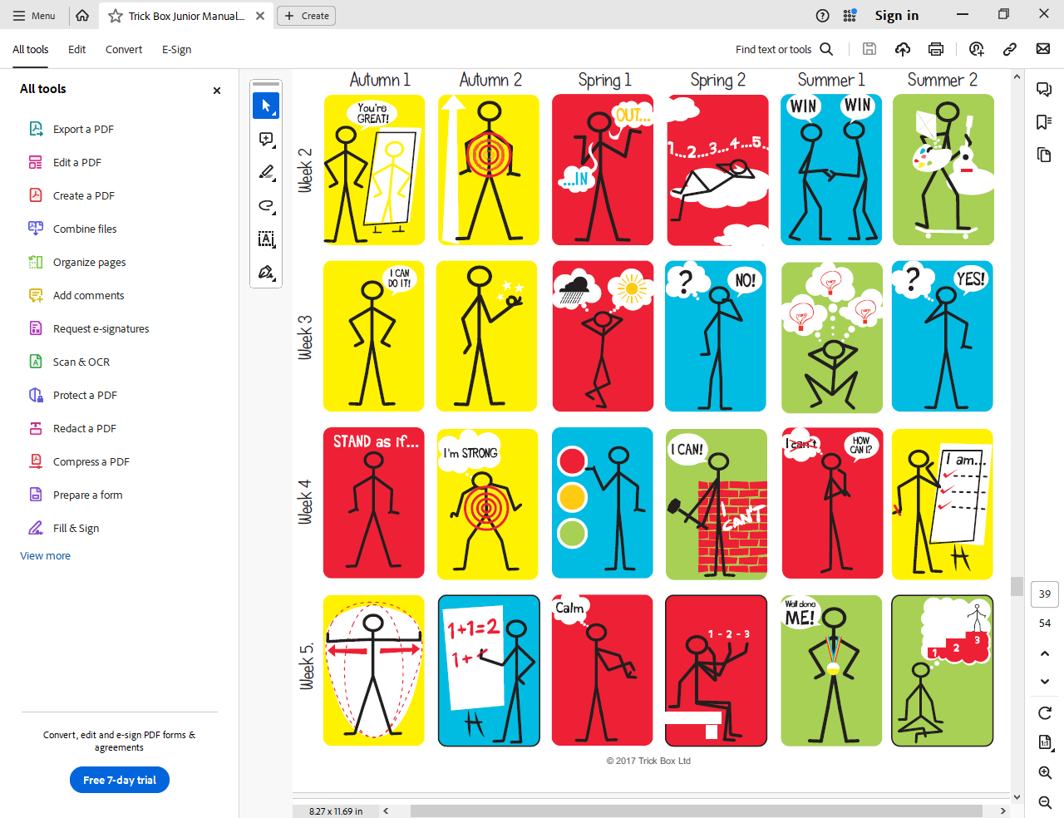
YEAR 6
Autumn
Spring
Summer
Different Sum
If I change my methods,
I get different results
1 2 3 Magic
Take steps to relax, think and find a solution
Great Goals
I will succeed!
In order for a different outcome to occur we need to do something different – create a new sum1
Encourage your child to think of new ways to do things - help them to see how different approaches = different results.
I can achieve more by finding new ways to do things.
Place your finger on your forehead- move your finger away a bit at a time until your mind starts to feel relax.
With a clear mind now use your tricks to help problem solve. Look at the problem in a new way and ask for help if needed.
I can use my tricks in a logical way to help influence the outcomes of my challenges.
Encourage your child to set themselves goals -break down these goals to 3 achievable steps.
Work with your child to visualise success – how will they accomplish each step – picture doing this over and over in your mind. Celebrate when each step is achieved.
The more you imagine reaching your goals the easier they become.
RECAP

