Slide 1
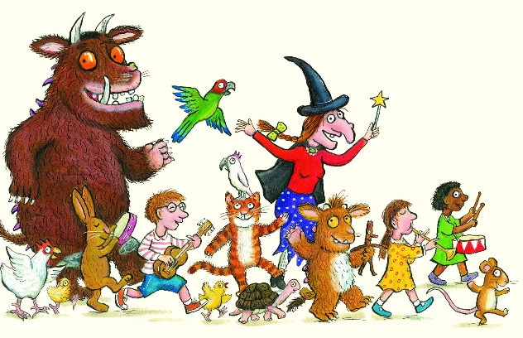
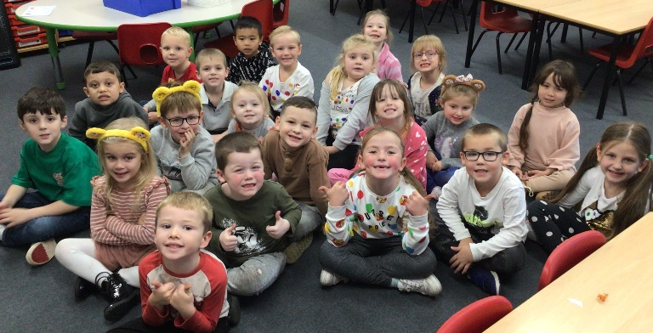
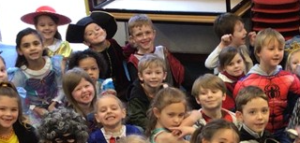
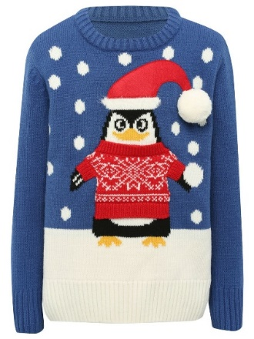

Whole school dressing up
Julia Donaldson Character Day – Autumn 1
Children In Need – Autumn 2
World Book Day – Spring 1
Christmas Jumper Day – Autumn 2
When I grow up day – Summer 2

Slide 2
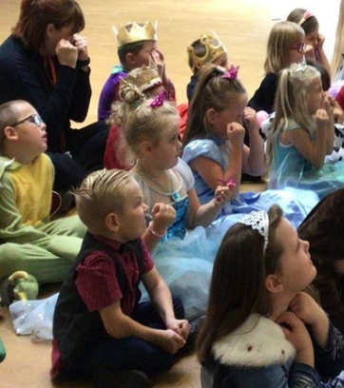
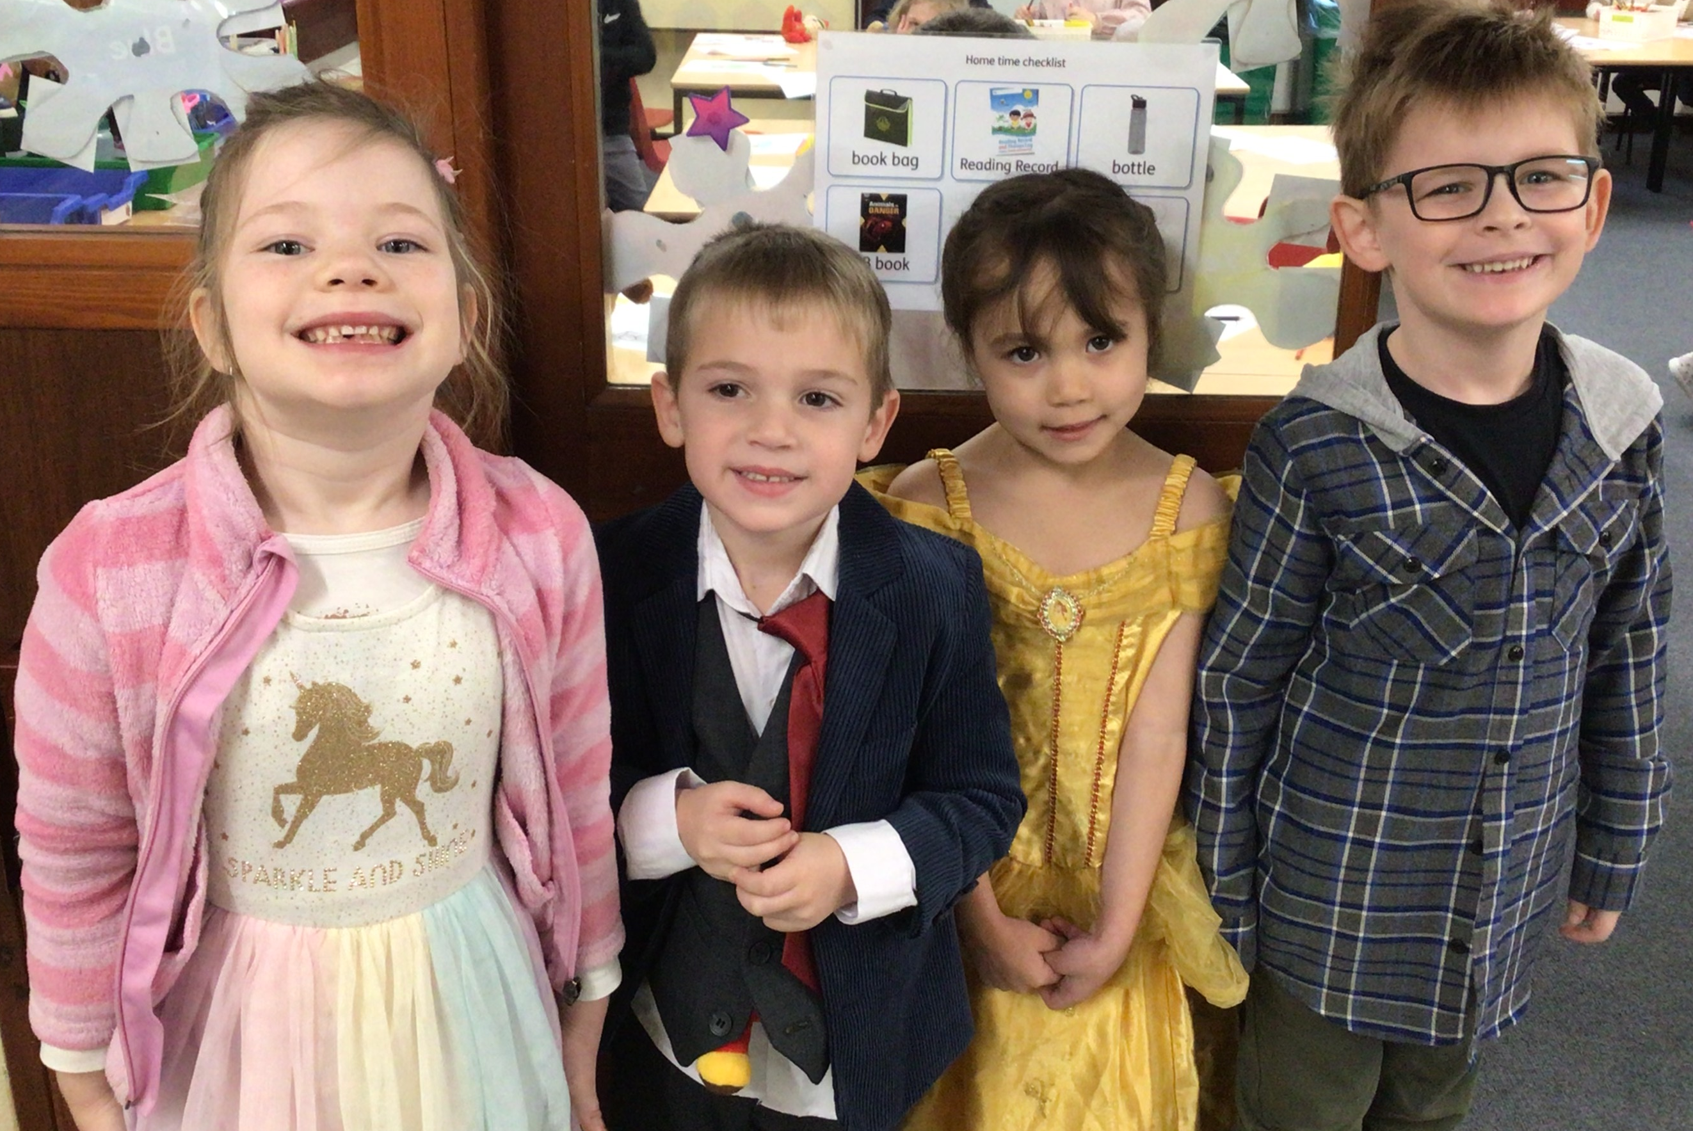
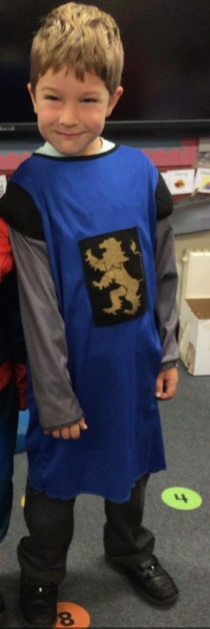
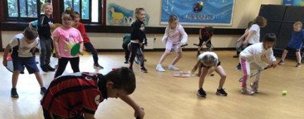
Dressing up in Year One
Paddington’s Party – Autumn 2
Fairy Tale Dress Up Day – Autumn 1
Storyteller Dress Up Day – Spring 2
Sports Activity Morning – Summer 2
Notes:
Kirstie

